Slide 1
CITY COUNCIL - ADOPTION HEARING
April 2, 2024

Slide 2
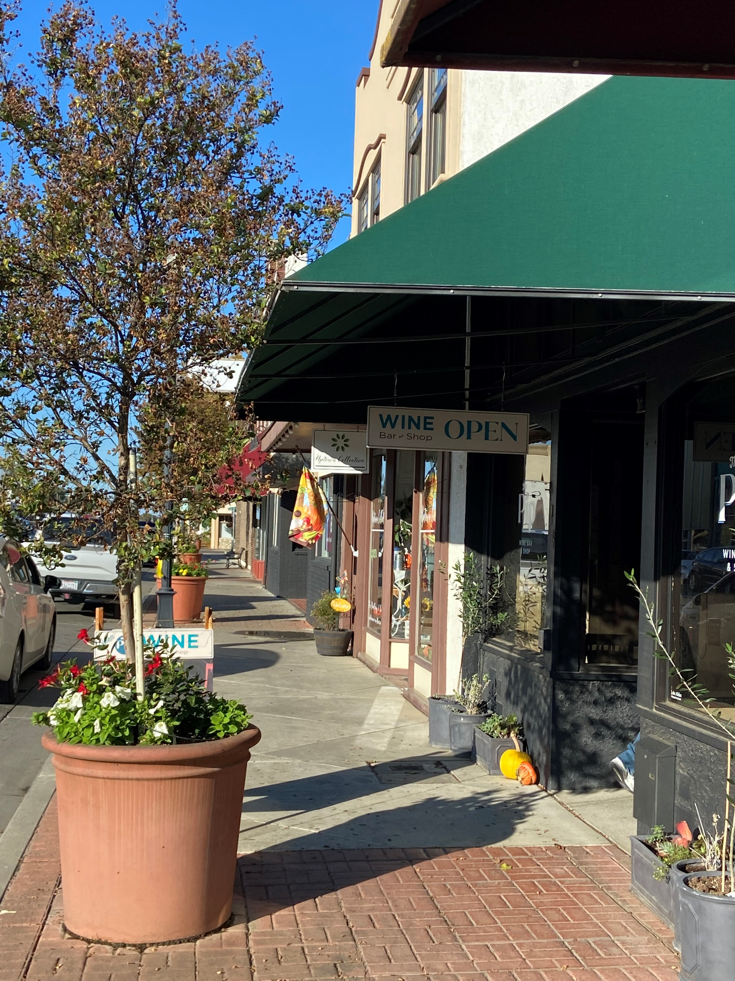
The Project
Dixon Zoning Code and Map Update
Comprehensive update of the Zoning Code (Title 18 of the Dixon Municipal Code) creating a concise and user-friendly set of regulations that will implement the General Plan’s vision for neighborhood preservation and enhancement, economic development, sustainable land use, and community health.

Slide 3
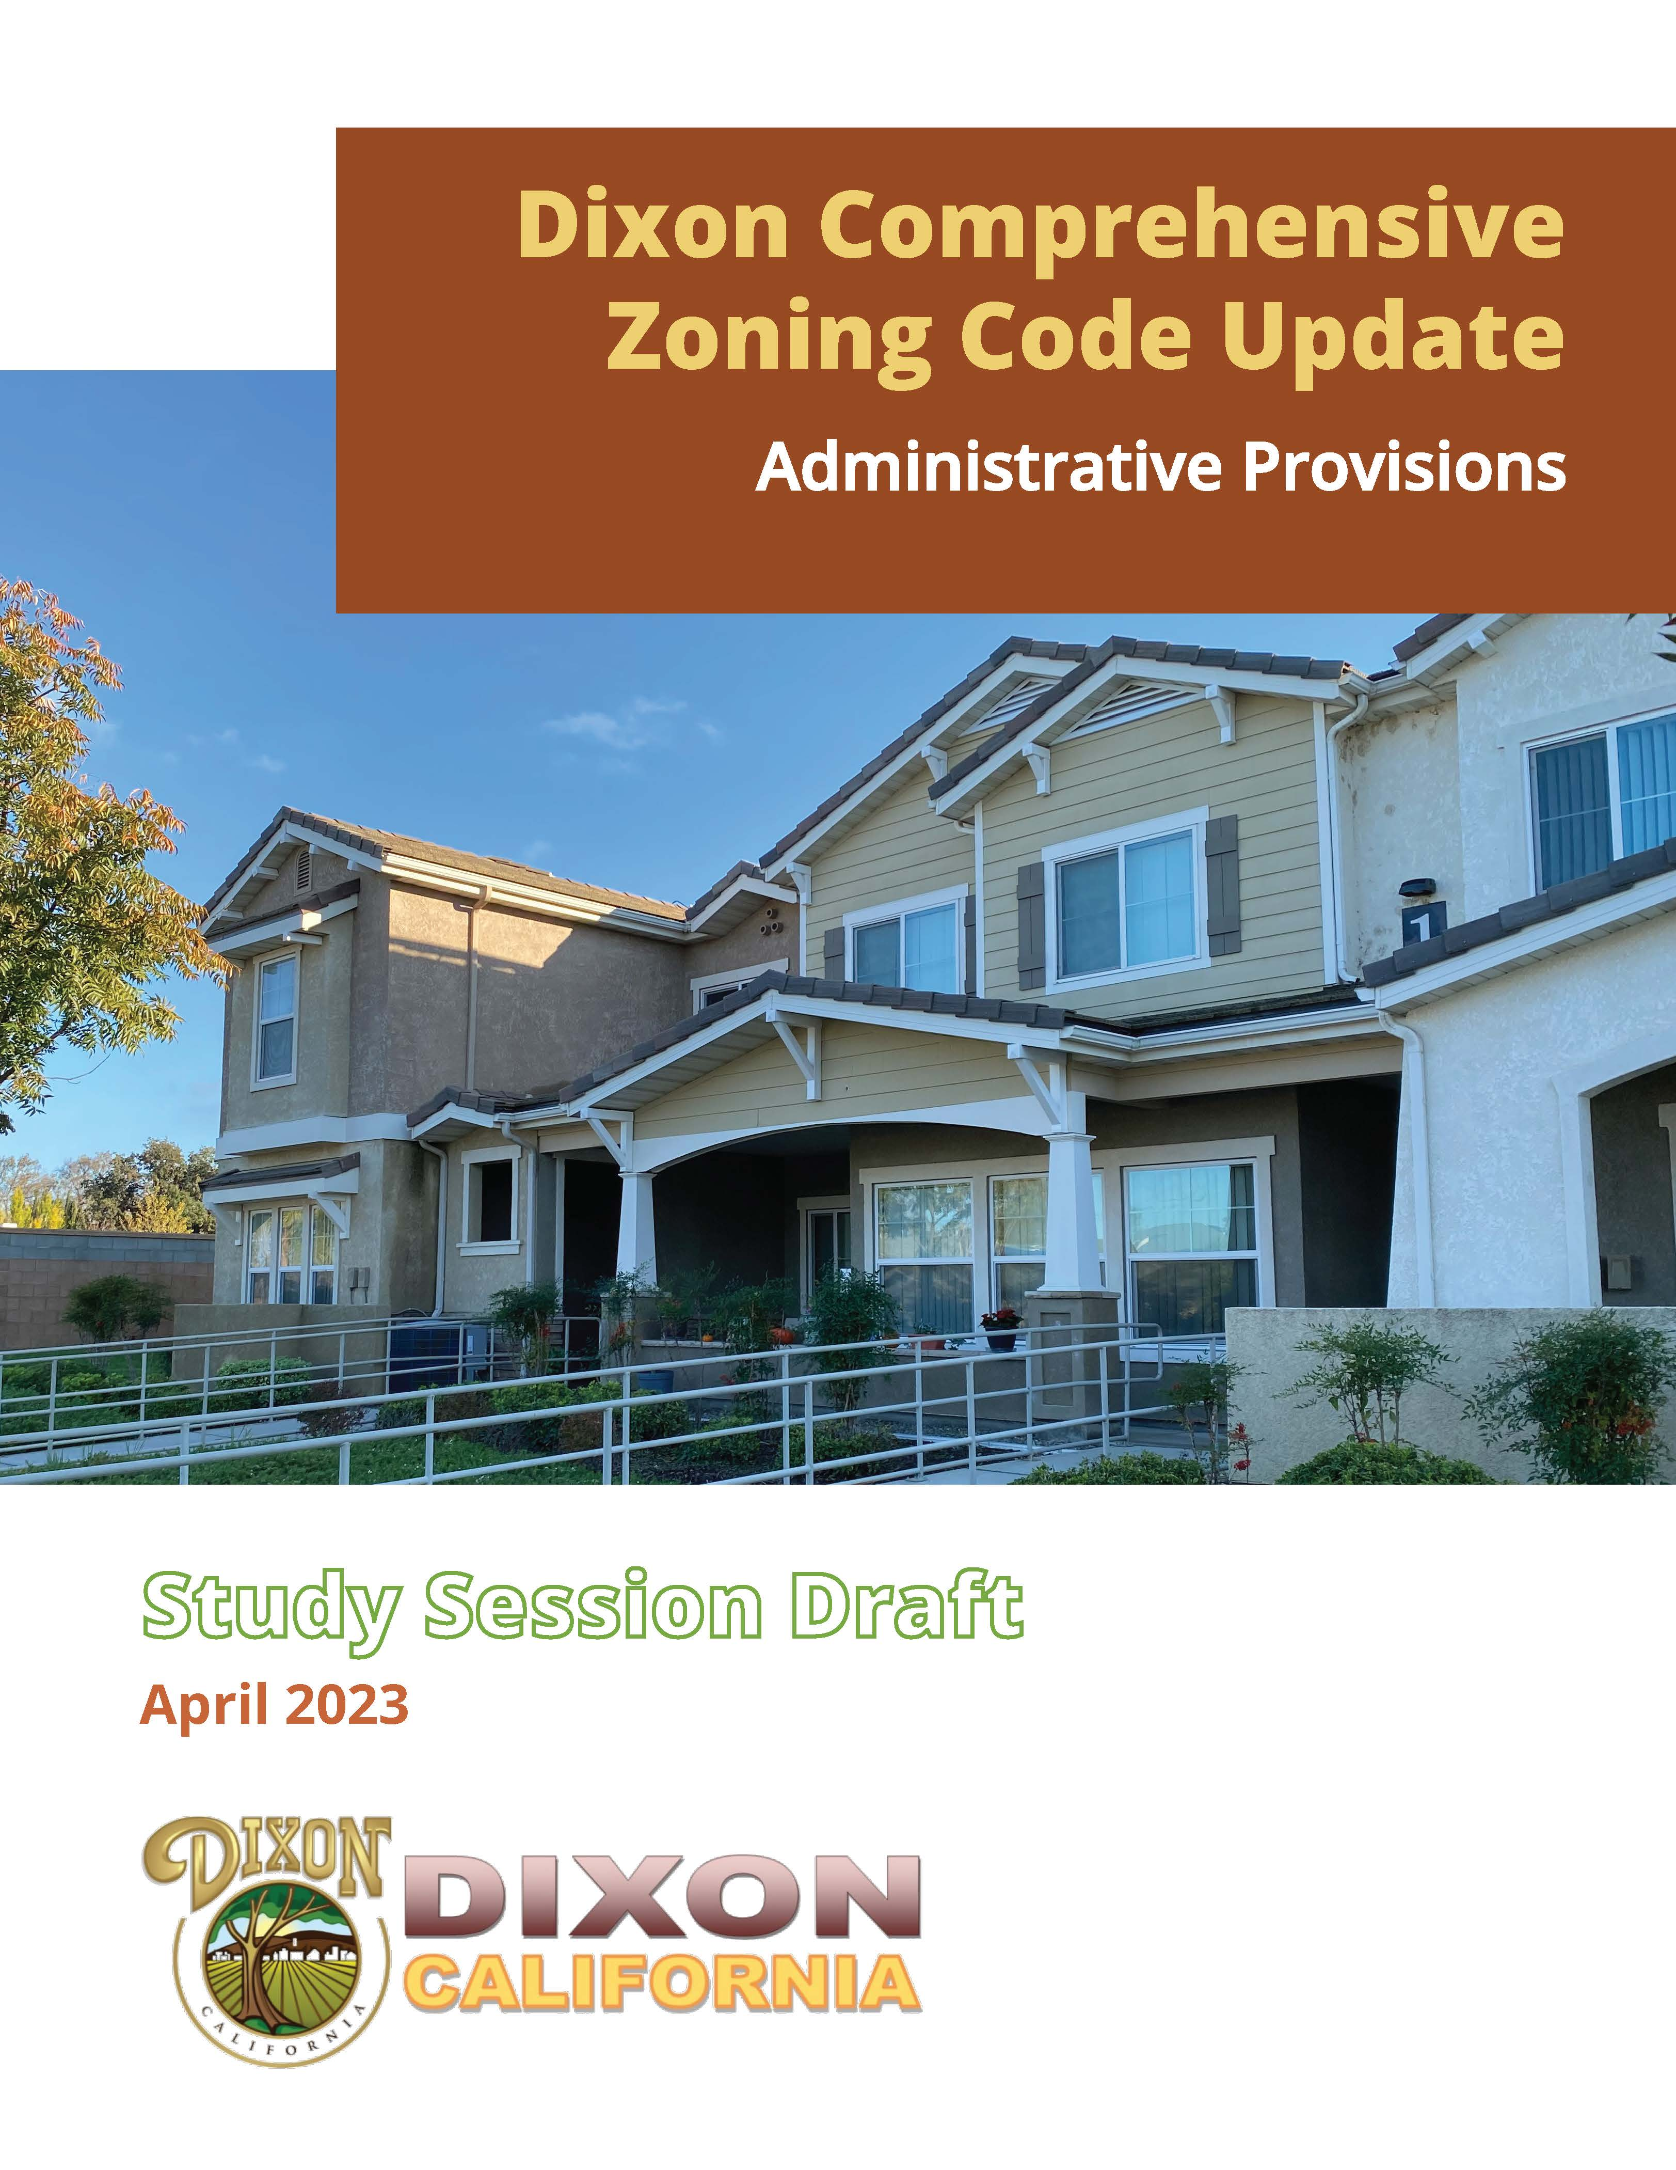
Process
Project Initiation, October 2021
Research and assessment, October 2021 – February 2022
Evaluation of approach recommendations, March 2022
Focus Area Workshops, July 2022
Community Survey – July –Aug 2022
Draft regulations and map (Study Sessions)
  District and use regulations – Jan 31, 2023
  Citywide standards – March 20, 2023
  CMX District follow-up & Administrative provisions – April 24, 2023
  Draft Zoning Code and Map – Released Dec 1, 2023
Hearings and adoption

Slide 4
Public Review Package Components
  Zoning Code
  Zoning Map
  Associated Municipal Code Amendments
  General Plan Amendments
  Planning Commission recommended adoption on 2/13/24 with revisions based on:
  Review of letter regarding concerns with minimum economic impact statement requirement for warehousing, storage, freight/trucking terminals and distribution facilities
  Distinguishing and further limiting unmanned donation boxes
  Review of Zoning Code as they relate to provisions relate to Religious Land Use and Institutionalized Persons Act (RLUIPA)
  Incorporation of staff recommended changes provided in memo provided by staff regarding clarification of residential density terminology and nonconforming provisions

Slide 5
Zoning Code

Slide 6
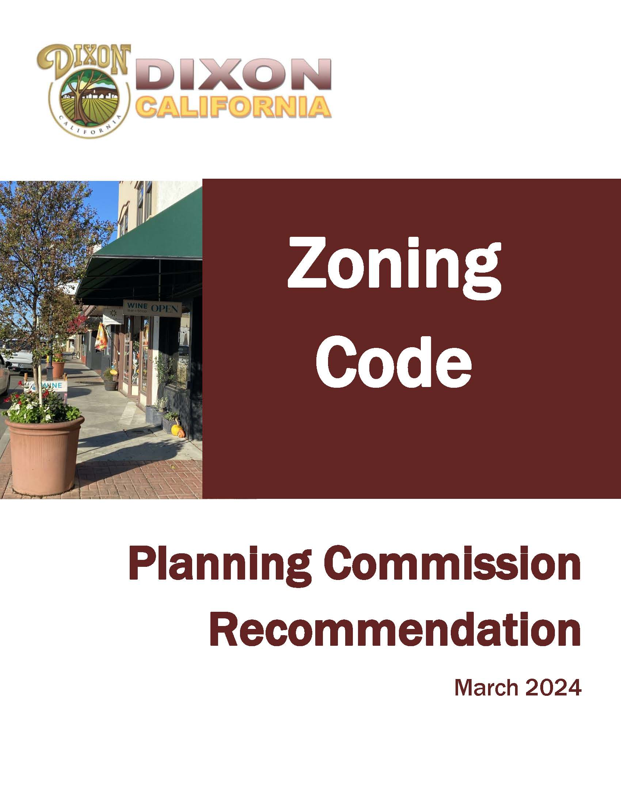
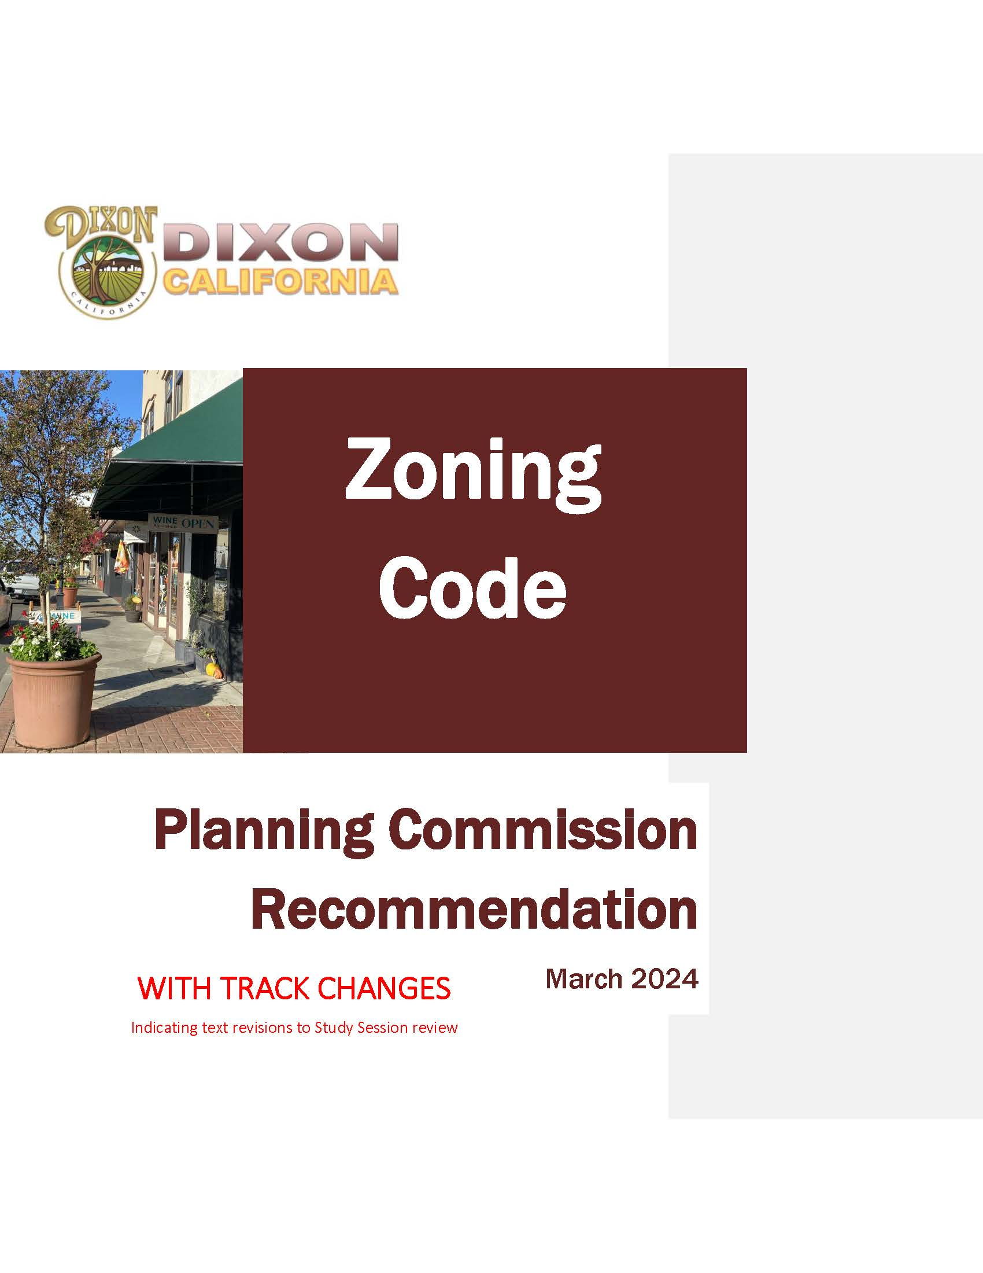
Zoning Code
  Organized into five divisions
  Division I: Introductory Provisions
  Division II: District Regulations
  Division III: Citywide Regulations
  Division IV: Administration and Permits
  Division V: Terms and Definitions

Slide 7
Zoning Code: Division I
  Division I: Introductory Provisions
  Establishes the overall purposes of the zoning code text and zoning map and the general rules that govern their applicability and use
  Preliminary draft Rules of Measurement reviewed in Study Session #2
    Revisions include clarification edits and edits for consistency with other revised sections of the draft regulations
    Inclusion of provisions for determining ‘Yards’, which were missing from the earlier draft
  No additional revisions as a result of the Planning Commission recommendation

Slide 8
Zoning Code: Division II
  Division II: District Regulations
  Zoning district-specific use allowances and development standards
  Preliminary draft reviewed in Study Session #1 and Study Session #3 (CMX)
  Revisions made for clarification and consistency and in response to study session discussion or other input received. Notable revisions include:
    Inclusion of Campus Mixed Use (CAMX) as a base zoning district and application of Specific Plan Districts as overlay districts rather than base zoning districts
    Refinements to use allowances for alignment with General Plan vision, including allowance for automotive related uses in mixed use areas elevated to Planning Commission level Use Permit to address potentially conflicting uses in mixed use areas
    Clarification that existing single family dwellings are allowed to remain in Downtown Mixed Use District; new single family dwellings are not allowed
    Removed allowance for Conditional Use Permit approval to allow detached single unit dwellings in CMX

Slide 9
Zoning Code: Division II
  Division II: District Regulations, continued
  Notable revisions, continued:
    Added North Jackson St and West A St to the list of streets where residential uses prohibited on the ground floor to increase pedestrian activity to the ground floor of the downtown, consistent with the General Plan
    Clarified amount of site frontage required to be occupied by a commercial use or common areas of residential development in order to meet the ‘active frontage’ requirement
    Added a clause that certificate of occupancy not be issued for a mixed use project until both residential and non residential uses are ready to issue concurrently to ensure both types of uses are developed
    Removed Broadcasting studios as an allowable use in Industrial Districts per study session comments

Slide 10
Zoning Code: Division II
  Division II: District Regulations, Planning Commission Recommendation
  Revisions pursuant to Planning Commission recommendations:
    Review Zoning Code as it relates to RLUPIA
      Religious institutions are considered a Community Assembly use
      Language added to purpose statement of Downtown Mixed Use District to clarify why Community Assembly uses are limited
      Removed acreage and location limitation on Community Assembly uses in CMX, CN, and CS zones
    Unmanned donation centers
      New land use category for Donation Center/Stations to distinguish recycling from unmanned donation boxes
      Allow unmanned donation boxes in IG and IL Districts with an Administrative Use Permit
    Incorporation of staff recommended changes related to terminology for residential density

Slide 11
Zoning Code: Division III
  Division III: Citywide Regulations
  Standards that apply to all or some zoning districts throughout the City
  Preliminary draft reviewed in Study Session #1 (Standards for Specific Uses) and Study Session #2
  Revisions made for clarification and consistency and in response to study session discussion or other input received. Notable revisions include:
    Clarified applicability of what are considered detached or attached accessory structures
    Clarified that dense hedges outside of required front or street side setbacks are not subject to fence height limits
    Removed the 3 ft setback from property lines for mechanical equipment for pools
    Removal of standards for site distance already covered in the City’s Engineering and Design Standards
    Replacement of draft landscaping provisions related to water conservation with applicable cross-reference
    Clarification of parking location limitations in low density residential districts to ensure visibility at driveways entrances
    Adjust threshold for warehousing, storage, freight/trucking/distribution facilities where a minimum economic impact benefits is required

Slide 12
Zoning Code: Division III
  Division III: Citywide Regulations, Planning Commission Recommendation
  Revisions pursuant to Planning Commission recommendations:
    Economic Impact Statement requirement for Warehousing, Storage, Freight/Trucking Terminals and Distribution Facilities
      Simplify section and require Economic Impact Statement for projects greater than 150,000 square feet (eliminating requirement for facilities smaller than 150,000 square feet)
      Requires an agreement to provide offsetting benefits if Minimum Economic Impact is not met
      Allows waiver of the agreement requirement if the City Council finds the project provides overriding benefits
    Incorporation of staff recommended changes related to clarification of when a nonconforming use can be reestablished in a structure that has been damaged or destroyed

Slide 13
Zoning Code: Division IV
  Division IV: Administration and Permits
  Provisions for the administration of the Zoning Code
    Conveys who is responsible for making decisions on zoning applications
    Presents permit approval process
  Updated provisions intended to:
    Clarify decision makers and review procedures
    Maintain the bulk of existing provisions
  Preliminary draft reviewed in Study Session #3
    Revisions include requirement for design review of exterior alterations of existing structures with 12 or more residential units
    Provisions for Development Agreements adopted January 17, 2023 carried forward
  No additional revisions as a result of the Planning Commission recommendation

Slide 14
Zoning Code: Division V
  Division V: Terms and Definitions
  Definitions of the land uses regulated by the Zoning Code (Use Classifications) and commonly used terms
  Preliminary draft Use Classifications reviewed in Study Session #1
    Revisions include clarification edits and edits for consistency with other revised sections of the draft regulations
    Broadcast studios incorporated into broader ‘office’ category
  Additional revisions as a result of the Planning Commission recommendation
    New Donation Center/Station land use classification
    Distinguishing refinements to Recycling Centers land use classification

Slide 15
Zoning Map

Slide 16
Zoning Map
  Objective of the Zoning Map Update
  Implement General Plan Land Use Designations
    Add new Zoning Districts for new General Plan Land Use Designations
    Remove Zoning Districts related to obsolete General Plan Land Use Designations
  Make zoning easier to use and understand
    Reduce the overall number of Zoning Districts
    Consolidate similar Districts
General Plan 2040 Land Use Designation | Proposed Zoning District
Residential Districts
Low Density Residential | Residential Low Density (RL)
Medium Density Residential | Residential Medium Density (RM)
Commercial and Mixed-Use Districts
Corridor Mixed Use | Corridor Mixed Use (CMX)
Downtown Mixed Use | Downtown Mixed Use (DMX)
Campus Mixed Use | Campus Mixed Use (CAMX)
Neighborhood Commercial | Neighborhood Commercial (CN)
Regional Commercial | Regional Commercial (CR)
Service Commercial | Service Commercial (CS)
Industrial Districts
Industrial | Light Industrial (IL)
 | General Industrial (IG)
Public and Semi-Public Districts
Public Facilities | Public Facilities (PF)
Parks | Parks and Recreation (PR)
Specific Plan Overlay Districts
Multiple | Northeast Quadrant Specific Plan Overlay District (NE-SP)
Multiple | Southwest Dixon Specific Plan Overlay District (SW-SP)
Notes:
MM insert table

Slide 17
Zoning Map
  New Zoning Districts to implement new General Plan Land Use Designations
    Corridor Mixed Use and Downtown Mixed Use and Campus Mixed Use
  Remove obsolete Districts that do not correspond to a General Plan Land Use Designation
    Community Commercial (CC), Professional Administrative Office (PAO), Agriculture (AG), Assembly Overlay, and Temporary (T)
  Rename Zoning Districts to reflect General Plan terminology (ex. R-1 ➔ RL)
  Consolidate similar Districts (ex. RM-1, RM-2, RM-3, and RM-4)
  Include Planned Development (PD) Overlay as second map sheet
    Combined current duplicative Planned Unit District and Planned Development District

Slide 18
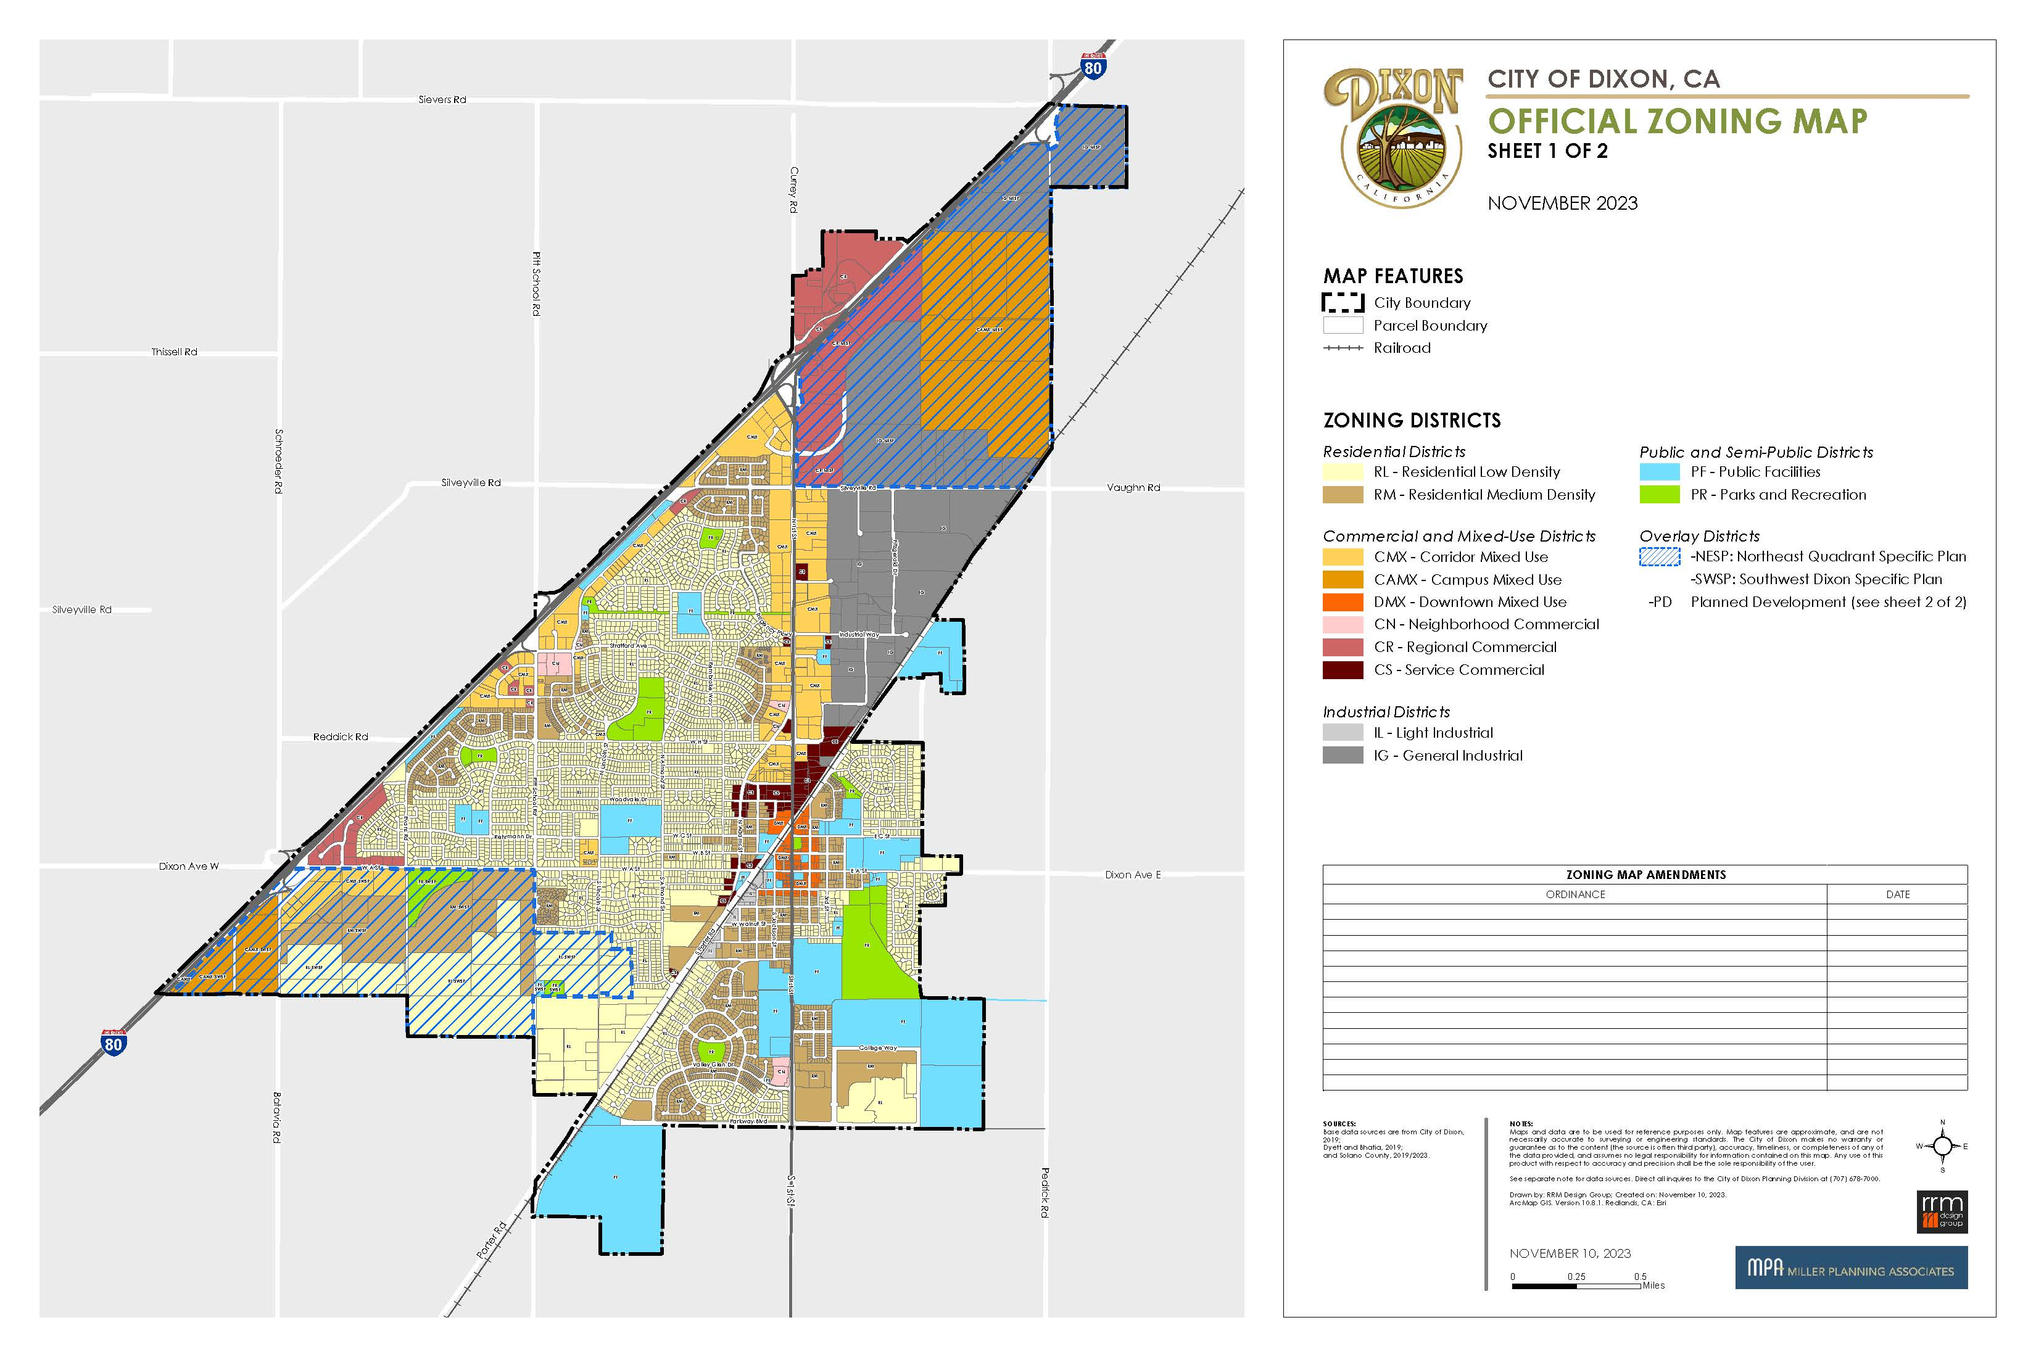
Zoning Map

Slide 19
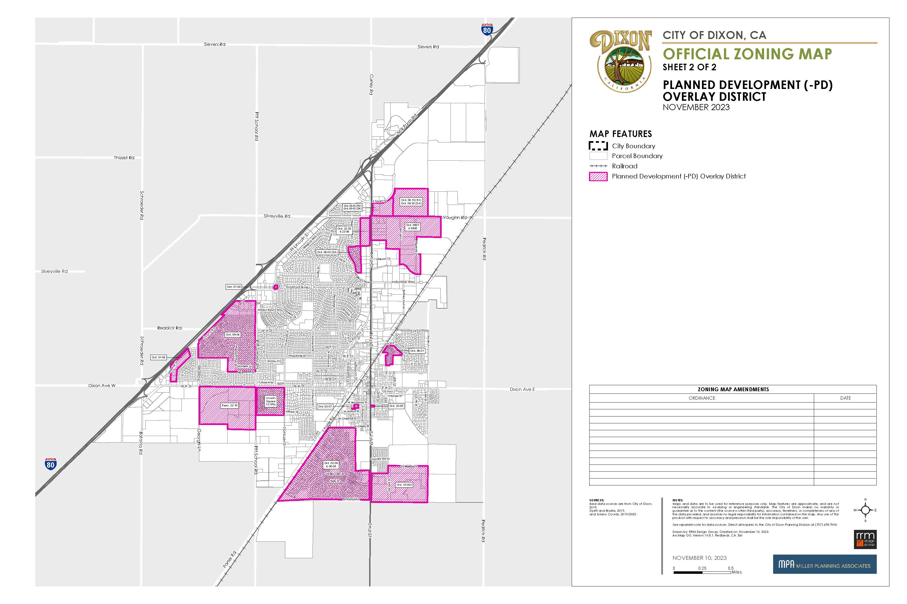

Slide 20
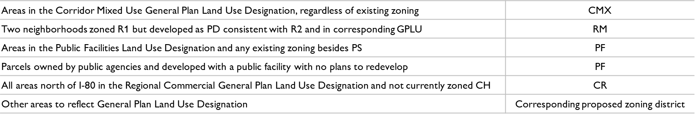
Zoning Map
  Reclassification (5,400 parcels)
  Parcels whose existing zoning matches the corresponding General Plan land use designation (ex. R-1 current zoning, RL General Plan designation, ‘reclassified’ to RL zoning)
  Rezoning (731 parcels)

Slide 21
Municipal Code

Slide 22
Municipal Code Amendments
  Amendments to other sections of the Municipal for consistency with terminology and cross references with the new Zoning Code.
  Cannabis Business Pilot Program (DMC Sections 6.12.040.B.2 and 6.12.040.E)
  Kennels and Catteries – Generally (DMC Section 7.03.010)
  Bees (DMC section 7.04.050)
  Noise control (DMC Section 9.05.010)
  Emergency Medical Service First Responder Fee (DMC Section 11.14.070)
  Shopping Car Regulation (DMC Section 11.15.040)
  Trucks and Truck Routes within the City Limits (DMC Section 12.06.050)
  Street Trees (DMC Section 13.05.030)
  Water (DMC Section 14.02.275), and
  General Provisions of Subdivision Ordinance (DMC Section 17.01.040)

Slide 23
General Plan Amendments

Slide 24
General Plan Amendments
  “Downtown Mixed Use” (DMU) and “Campus Mixed Use” (CAMU) land use designation descriptions. Clarify the intent, rules, and standards of the land use designations
  Land Use Map Amendments. Correct the General Plan land use designation on certain parcels to correct mapping errors that occurred in development of General Plan Land Use map
  Notice was sent to CAMU, DMU, and land use map amendment affected properties, published in the paper, and emailed to the email distribution list

Slide 25
General Plan Text Amendments
  Downtown Mixed Use (DMU).
    Allow single or mixed-use development on small or large parcels
    Active uses must be located on the ground floor along primary corridors
    Aim to allow greater flexibility of mixed-use development opportunities within the downtown area
  Campus Mixed Use (CMU).
    Objective standards to clarify the mix and intensity of uses allowed in the CAMU to reflect the intent and desire for the area
    Recent State law limits a city’s ability to regulate certain projects based only on objective standards
    Refinements are necessary to maintain the city’s desire to have the area develop with predominantly non-residential uses that generate sales tax, employment or services for surrounding residents, while allowing for supporting residential development as a secondary use

Slide 26
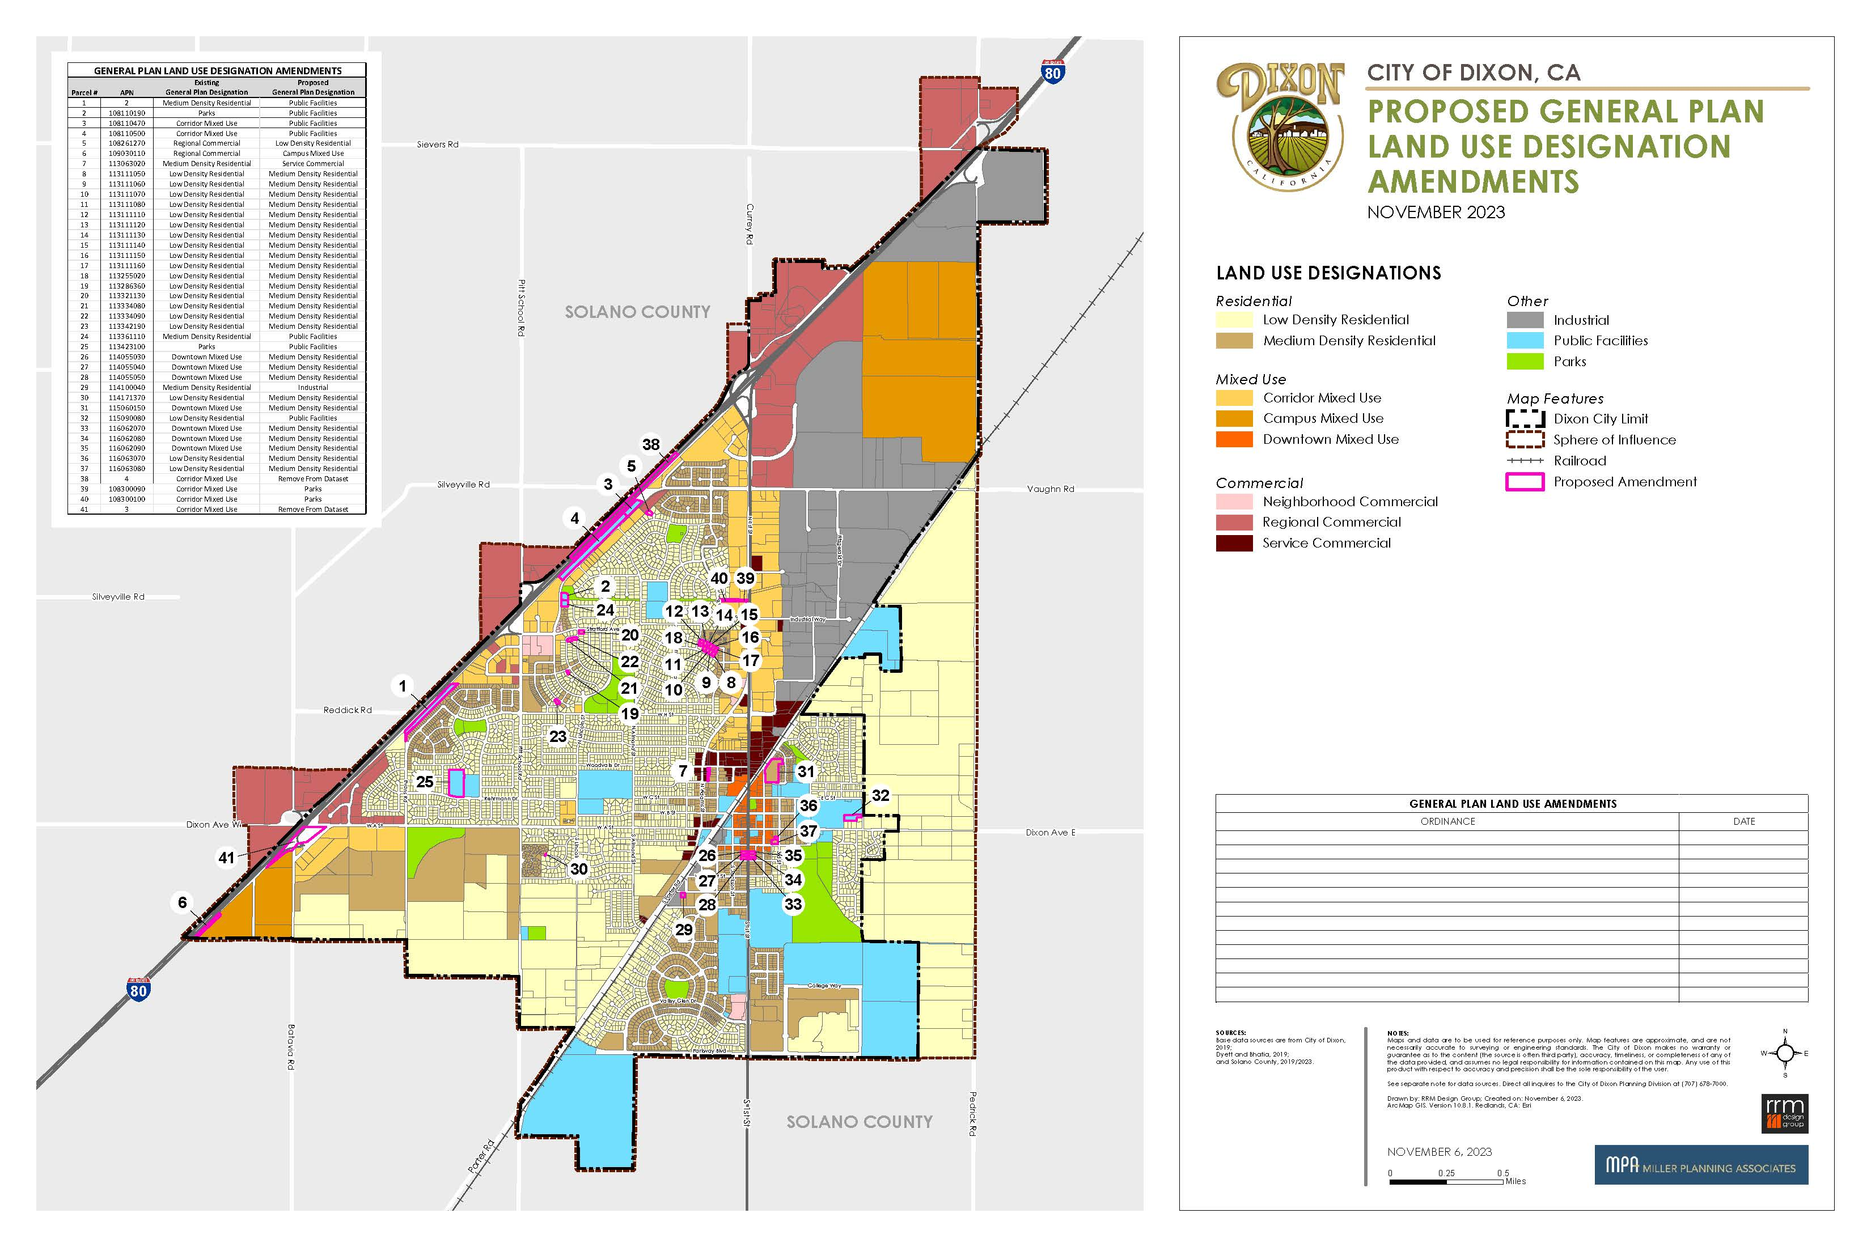
General Plan Land
Use Map Amendments
    Updates to align with current zoning, ownership, and use discovered through parcel by parcel analysis conducted in preparation of the Draft Zoning Map

Slide 27
CEQA

Slide 28
CEQA
  No further environmental review is required for the project.
  The Environmental Impact Report that was certified for the original General Plan 2040 applies to this project and there are no additional significant impacts, pursuant to CEQA Guidelines section 15162 (Subsequent EIR).
  This project is also exempt from environmental review, pursuant to CEQA Guidelines section 15061(b)(3) (Commonsense Exemption).

Slide 29
Public Comments Received

Slide 30
Public Comments Received
Prior to Study Session – Included in staff report
Since Study session thru City Council Mtg – Included in staff report or supplemental
    Letter & email from Michael Sawyer, 12/1/23 & 2/11/24
    Letter from Stanton Hales, 2/4/24
    Letter from Calvary Church re DMX zoning and churches, 2/12/24
    Letter from Ginger Emerson re variety of topics with prior letters attached, 2/13/24
    Letter from Marcus LoDuca Re warehouse distribution uses and new econ benefit section, 2/13/24
    Letter from Nick Avdis Re warehouse distribution uses and new econ benefit section, 3/11/24
    Letter from Yoche Dehe, 3/25/24
    Letter from Chad Roberts Re single family in CMX, 3/28/24
    Letter from Ginger Emerson, 4/1/24

Slide 31
Next Steps

Slide 32
Next Steps
Planning Commission made recommendation on the proposed Zoning Code, Zoning Map, General Plan, and associated Municipal Code amendments
The City Council to now consider final adoption
Planning Commission Recommendation
City Council Adoption

Slide 33
Recommendation

Slide 34
Recommendation
The Planning Commission and staff recommends the City Council:
    Conduct Public Hearing
    Adopt the following in this specific order:
      Adopt a Resolution approving amendments to the Dixon General Plan 2040 land use map and definitions of two land use designations (Campus Mixed Use and Downtown Mixed Use) to: 1) Correct errors discovered during the Comprehensive Zoning Ordinance and Map update project, and 2) Refine and clarify the City’s intent and vision for the two land use designations; and
      Waive first reading, read by title only, and introduce an Ordinance of the Dixon City Council: 1) Repealing and re-enacting Title 18 (Zoning) of the Dixon Municipal Code, 2) Repealing and reenacting City of Dixon Zoning Map, and 3) Amending various sections of the Dixon Municipal Code (Comprehensive Zoning Ordinance and Map Update).

Slide 35
Discussion

Slide 36
Stay Involved
Project Website
Access upcoming meetings, all current and past project documents, and more.
http://www.cityofdixon.us/ZoningUpdate
Contact City staff:
Raffi Boloyan, Community Development Director
rboloyan@cityofdixon.us

Slide 37
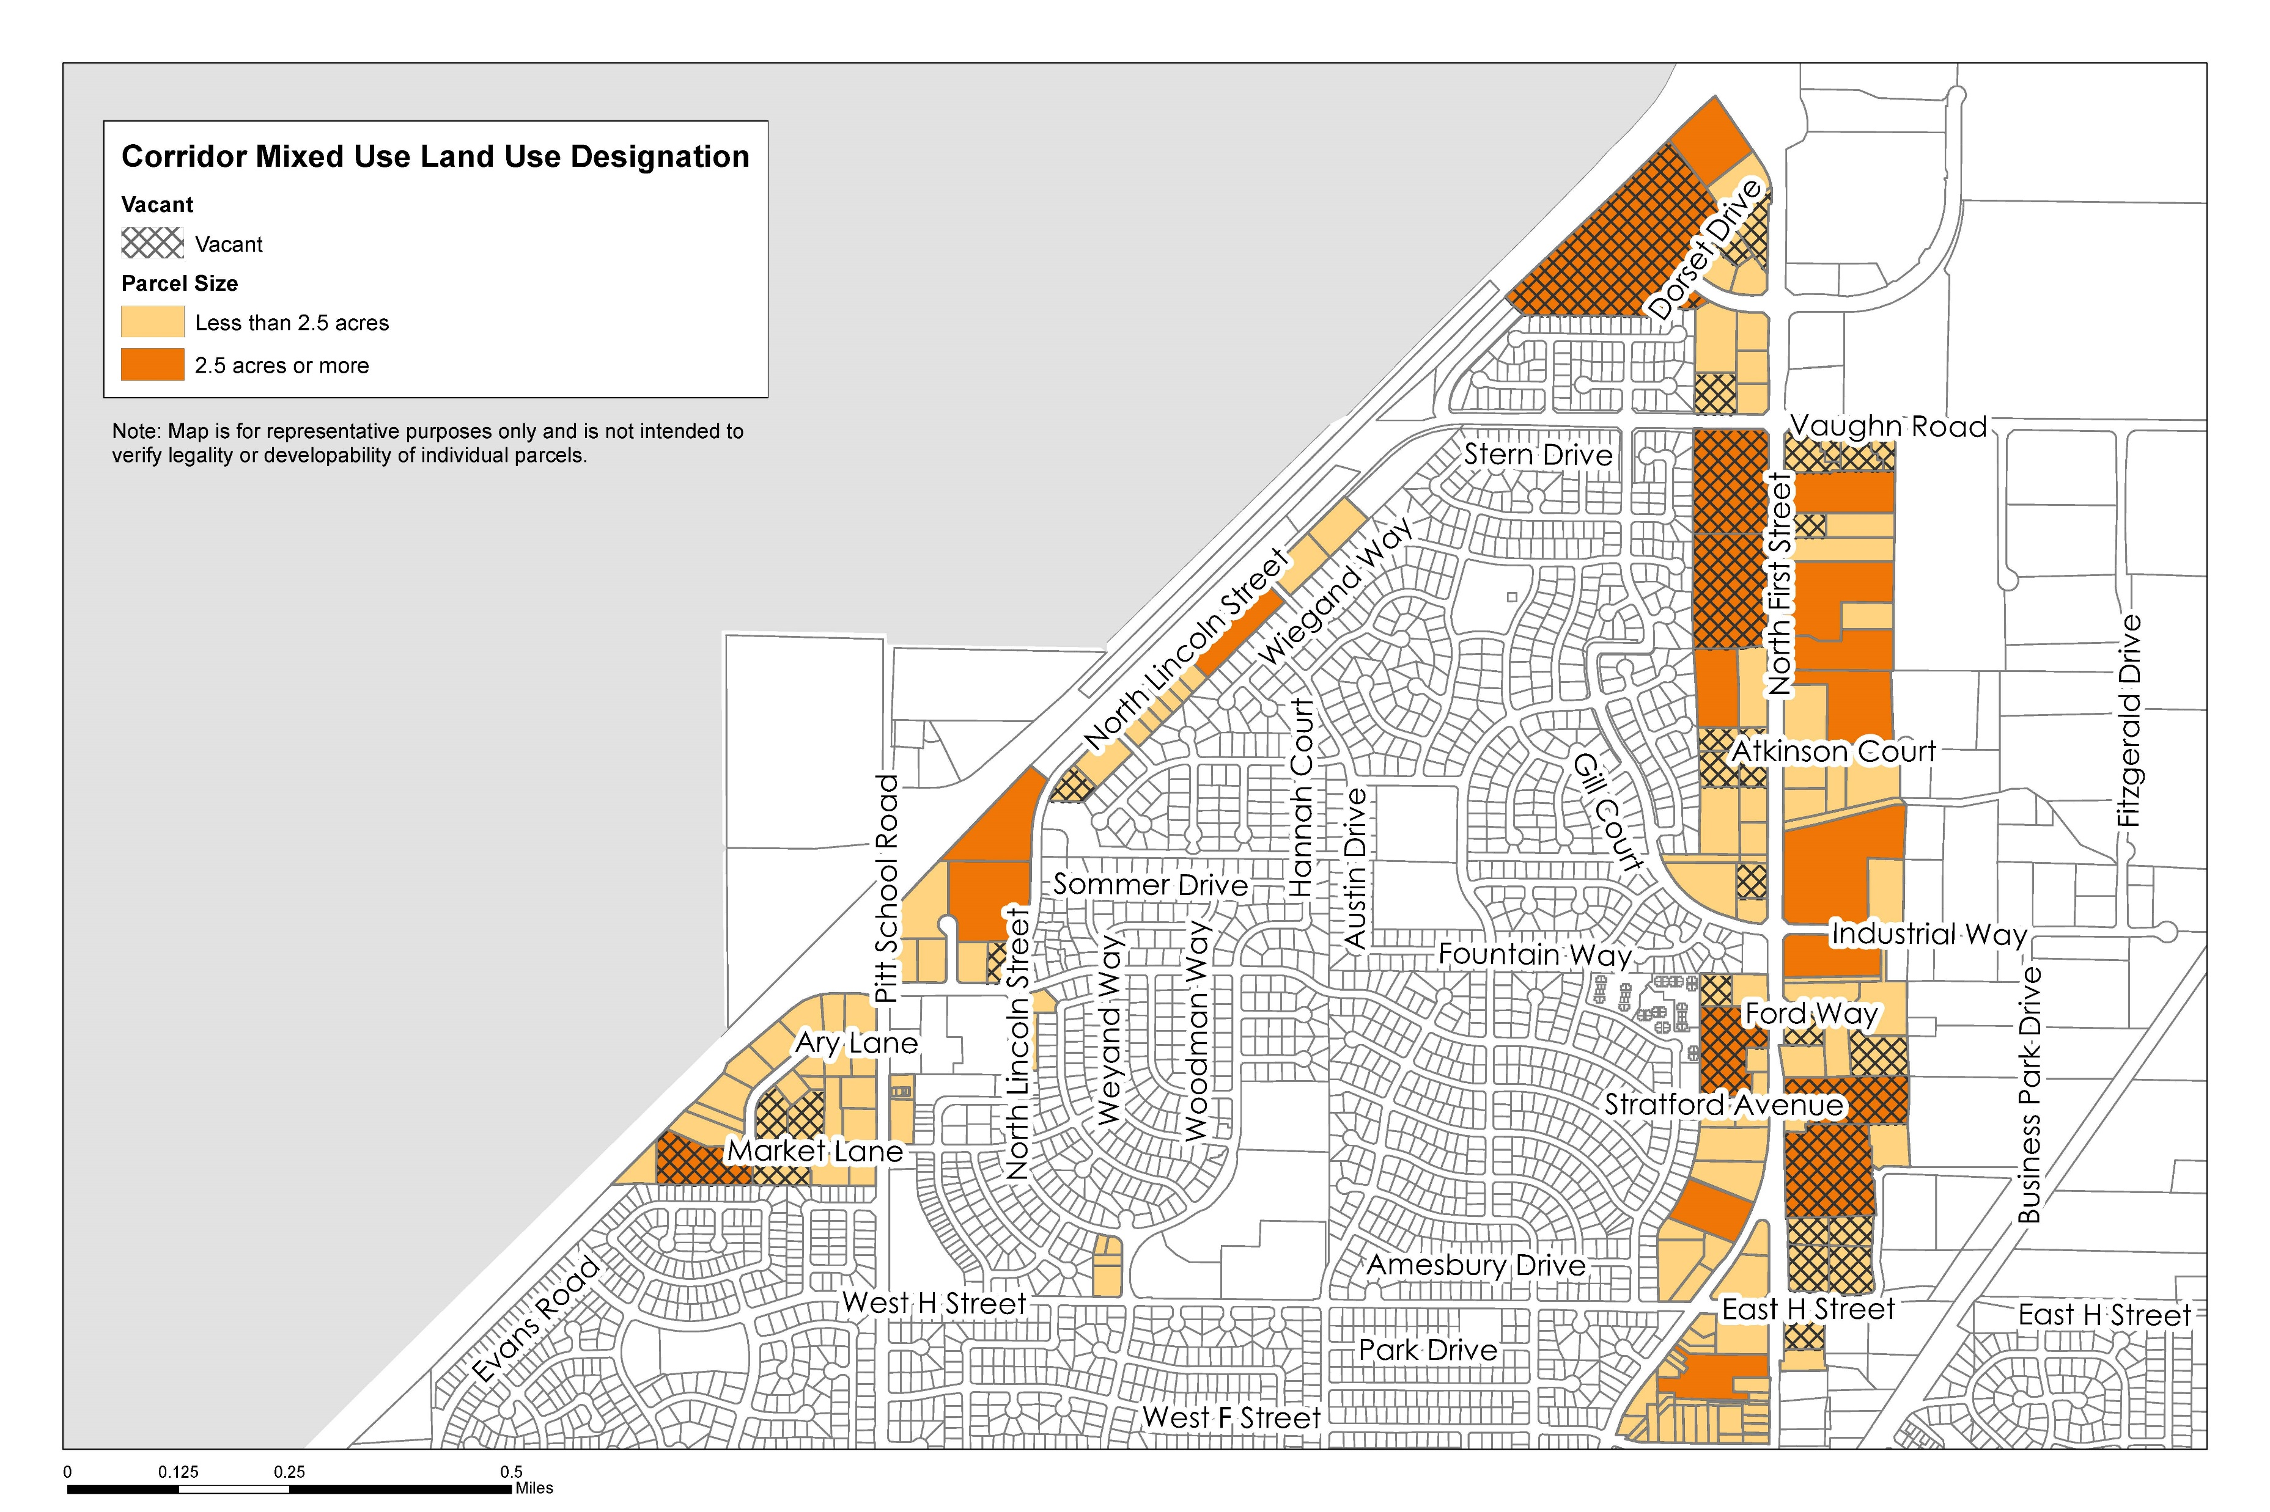
Corridor Mixed Use
  District Standards Staff Recommendation:
  ‘Small’ site: Less than 2.5 acres
  Single- or mixed-use allowed
  ‘Large’ site: 2.5 acres or larger
  Mixed-use required
  With limitations and requirements

Slide 38
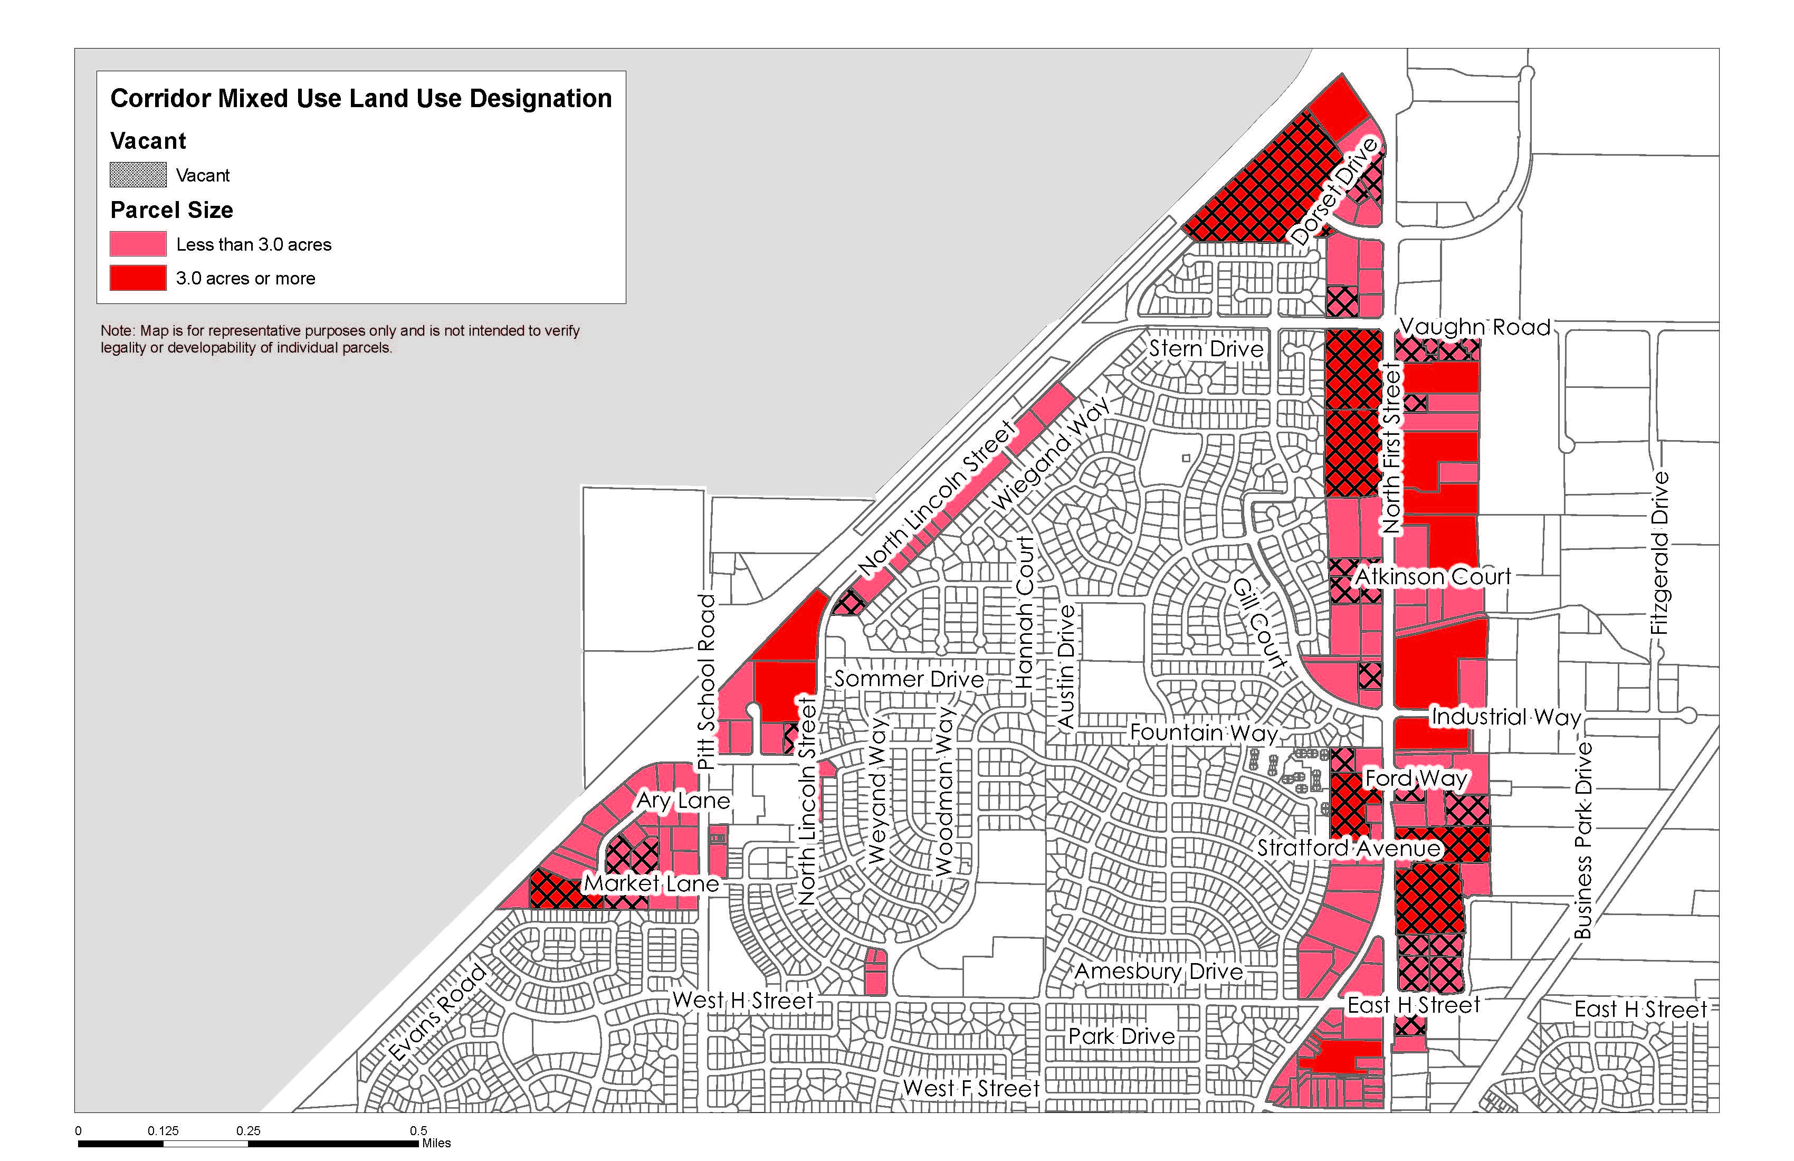
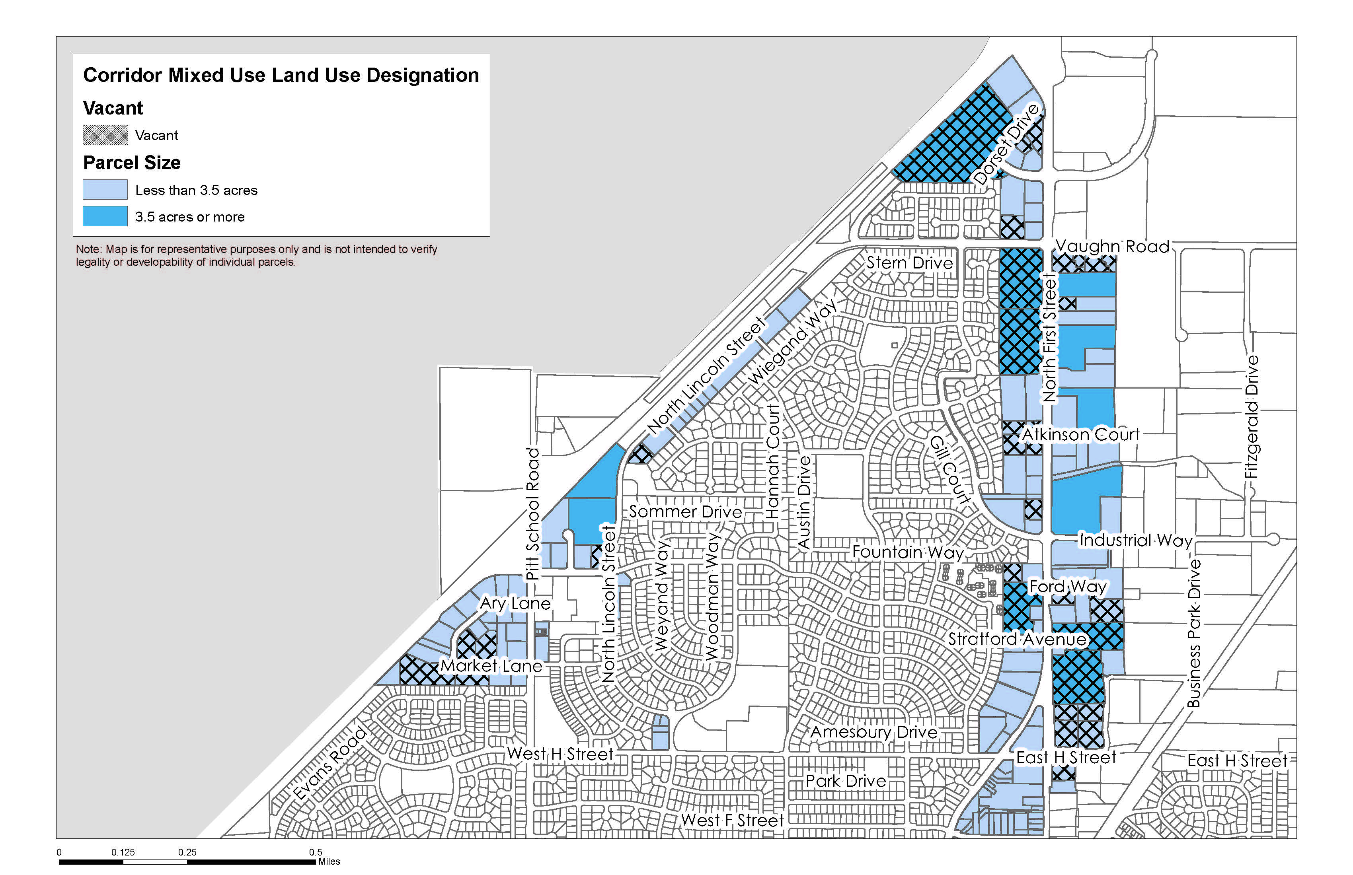
Corridor Mixed Use

